Slide 1
BINARY MULTILINGUAL MACHINE-GENERATED TEXT DETECTION
PIP2001 Capstone Project
Review-0
Batch Number:CSE 33
ROLL NUMBER | STUDENT NAME
20211CSE0143 | GADDAM JAHNAVI
20211CSE0144 | UPPARAPALLI YASHASWINI
20211CSE0169 | JETTI MEGHANA
20211CSE0133 | KAMBHAMPATI KOWSHIK NARAYAN
Under the Supervision of,
Dr./Mr./Prof.Jayachandran A
Professor / Associate Professor / Assistant Professor
School of Computer Science and Engineering
Presidency University
Name of the Program: CSE
Name of the HoD: Dr. Blessed Prince P/Dr. Robin Rohit/Dr.Asif Mohammed H.B
Name of the Program Project Coordinator: Mr. Amarnath J.L & Dr. Jayanthi. K.
Name of the School Project Coordinators: Dr. Sampath A K / Dr. Abdul Khadar A / Mr. Md Ziaur Rahman

Slide 2
Content
Problem Statement
Github Link
Analysis of Problem Statement
Timeline of the Project
References

Slide 3
Problem Statement Number:
Category :Both Hardware And Software
Problem Description:Primary Goal: Train models to effectively distinguish between machine-generated and human-written texts, languages like English, Indonesian, German, Russian.
Expected Outcome: A predictive model capable of accurately determining whether an input text has been generated by a machine or authored by a human.
Approach:
Utilize advanced machine learning and deep learning techniques.
Perform multilingual text analysis.
Difficulty Level: Complex / Medium

Slide 4
Github Link
Github Link
https://github.com/20211CSE0143/Binary-multilingual-machine-generated-text-detection

Slide 5
Analysis of Problem Statement
Technology Stack Components:
Data Collection: Sources can include text corpora from news articles, social media, and open datasets like Common Crawl or multilingual datasets from platforms like Kaggle.
Preprocessing: Text Cleaning,Tokenization,lowercasing
Feature Extraction: Linguistic,Statistical,Classification
Model Training: Random Forest,LSTM,BERT,Decision Tree, Logistic Regression
Security:Ensure compliance with data protection regulations (e.g., GDPR, CCPA) when handling multilingual data.

Slide 6
Analysis of Problem Statement (contd...)
Software and Hardware Requirements:
H/W Configuration:
• Processor - I3/Intel Processor
• Hard Disk -160GB
• RAM - 8Gb
S/W Configuration:
Operating System : Windows 7/8/10 .
IDE : Pycharm.
Libraries Used : Numpy, Pandas, OS,django, MySQL.
Technology : Python 3.6+.

Slide 7
Analysis of Problem Statement (contd...)
In the digital age, the ability to distinguish between machine-generated and human-written text has become increasingly important due to the proliferation of automated content creation tools and the need for content authenticity.
The Binary Multilingual Machine-Generated Text Detection project addresses this challenge by developing a system that can accurately classify text as either machine-generated or human-authored, across multiple languages.
Given a diverse dataset containing textual features such as id, source, sub_source, lang, model, label, and text, the problem is to implement and evaluate various machine learning and deep learning algorithms to achieve high accuracy in text classification.
The core issue is to create a predictive model that can robustly handle multilingual inputs and effectively identify the origin of the text.
This involves the application of advanced algorithms, including Random Forest, Long Short-Term Memory (LSTM) networks, Bidirectional Encoder Representations from Transformers (BERT), Decision Tree, and Logistic Regression, to solve the problem of detecting and verifying the authenticity of textual content in a rapidly evolving digital landscape.

Slide 8
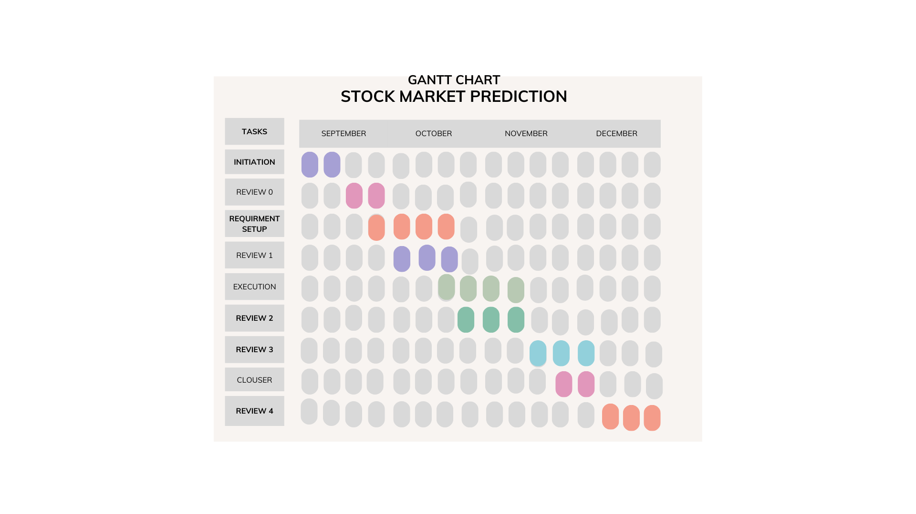
Timeline of the Project (Gantt Chart)

Slide 9
References (IEEE Paper format)
Han, T. R., & Kim, J. H. (2020). "A Survey on Text Classification: From Shallow to Deep Learning." IEEE Access, 8, 24430-24448.
Wu, Y., Wang, X., & Xu, X. (2022). "Multilingual Text Classification with Transformer Models." IEEE Transactions on Knowledge and Data Engineering, 34(6), 1019-1032.
Al-Hadhrami, F., Idris, M. I., & Al-Kahtani, A. (2020). "A Review of Text Classification Algorithms for Detecting Fake News." IEEE Access, 8, 134055-134070.
Li, J., Liu, Z., & Wang, H. (2022). "Cross-lingual Text Classification Using Multi-View Learning." IEEE Transactions on Neural Networks and Learning Systems, 33(4), 1607-1620.
Sharma, N., Singh, S. S., & Kumar, V. P. (2022). "Deep Learning for Multilingual Text Classification: A Comparative Study." IEEE Transactions on Emerging Topics in Computing, 10(2), 160-172.

Slide 10
References (IEEE Paper format)
Gupta, R., Sharma, S., & Verma, S. (2019). "Automatic Detection of Machine-Generated Text Using Neural Networks." IEEE Access, 7, 164931-164939.
Singh, A., Gupta, B. K., & Singh, M. R. (2021). "Language-Agnostic Machine Learning Techniques for Text Classification." IEEE Transactions on Computational Social Systems, 8(2), 350-359.
Wang, C., Chen, Z., & Yu, J. (2021). "Multilingual Text Representation Learning for Cross-Lingual Text Classification." IEEE Transactions on Pattern Analysis and Machine Intelligence, 43(9), 3111-3122.
Lee, H. S., Park, J. K., & Kim, M. H. (2021). "Detecting Automated Content Generation: A Comprehensive Survey." IEEE Access, 9, 87545-87560.
Patel, K. N., George, A. J., & Zhang, N. L. (2022). "Enhanced Text Classification Models for Detecting Machine-Generated Text." IEEE Transactions on Artificial Intelligence, 3(1), 65-77.

Slide 11


